Slide 1
Docker

Slide 2
Why the buzz around Containers and Docker?
The software industry has changed
Before:
monolithic applications
long development cycles
single environment
slowly scaling up
Now:
decoupled services
fast, iterative improvements
multiple environments
quickly scaling out
3

Slide 3
Deployment becomes very complex
Many different stacks:
languages
frameworks
Databases
Many different targets:
individual development environments
pre-production, QA, staging...
production: on prem, cloud, hybrid
3

Slide 4
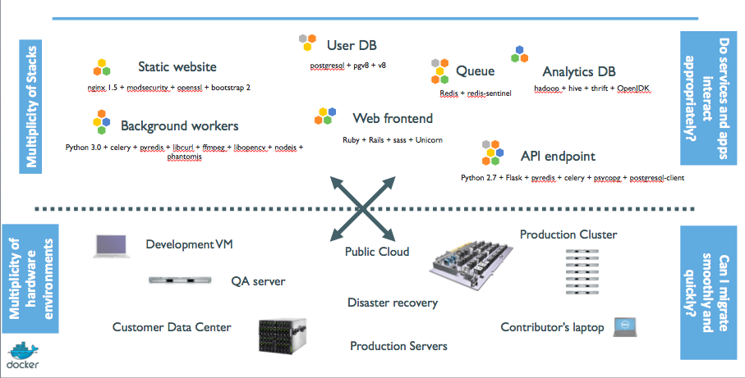
The deployment problem
3

Slide 5
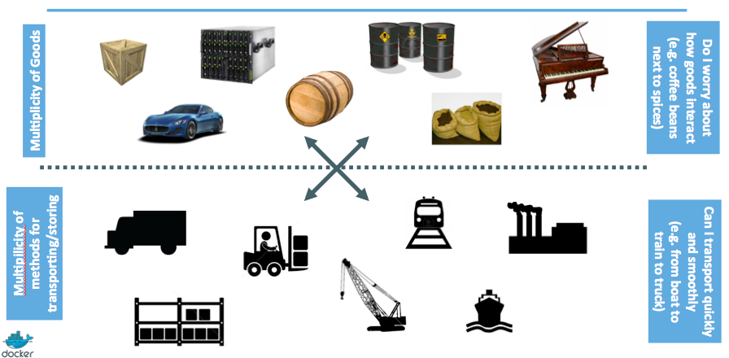
Analogy with the shipping industry
3

Slide 6
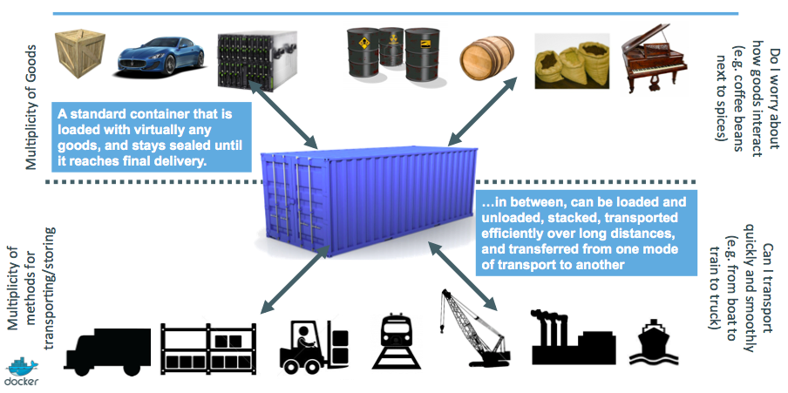
Intermodal shipping containers
3

Slide 7
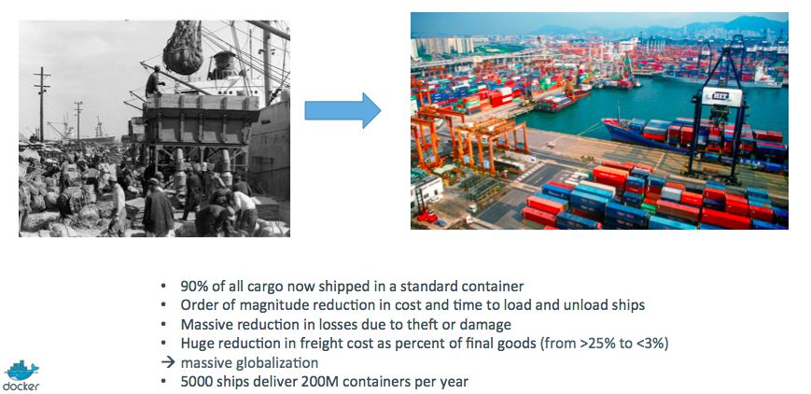
A new shipping ecosystem
3

Slide 8
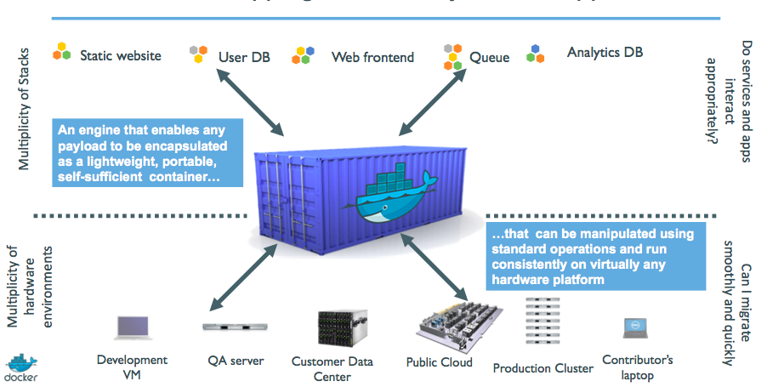
A shipping container system for applications
3

Slide 9
Results
Dev-to-prod reduced from 9 months to 15 minutes (ING)
Continuous integration job time reduced by more than 60% (BBC)
Deploy 100 times a day instead of once a week (GILT)
70% infrastructure consolidation (MetLife)
60% infrastructure consolidation (Intesa Sanpaolo)
14x application density; 60% of legacy datacenter migrated in 4 months (GE Appliances)
etc.
3

Slide 10

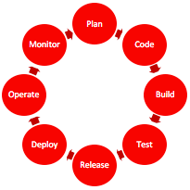

History and Multi-Dimensional Evolution of Computing
Development Process | Application Architecture | Deployment and Packaging | Application Infrastructure
Waterfall | Monolithic | Physical Server | Datacenter
Agile | N-Tier | Virtual Servers | Hosted
DevOps | Microservices | Containers | Cloud
Notes:
All of this is part of a transformation of technologies along a number of fronts, and is the basis for modern agile application development.

Slide 11
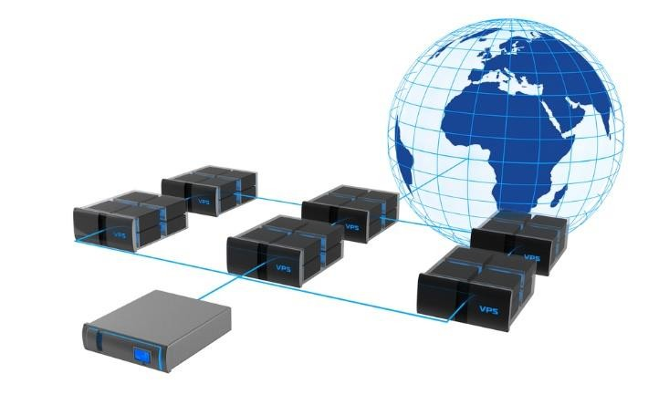
Virtualization
Virtualization means to create a virtual version of a device or resource, such as a storage device, server, network, an OS, hardware, etc. where the framework divides the resource into one or more execution environments.
→ Partitioning a hard drive is considered virtualization because one drive is partitioned to create two separate hard drives
→ Devices, applications and human users are able to interact with the virtual resource as if it were a real single logical resource
3

Slide 12
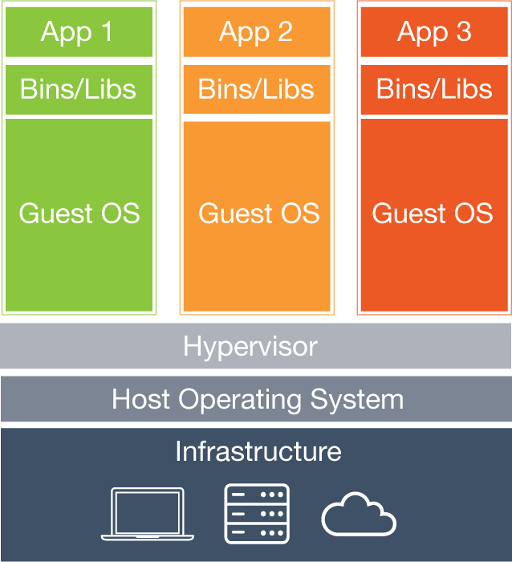
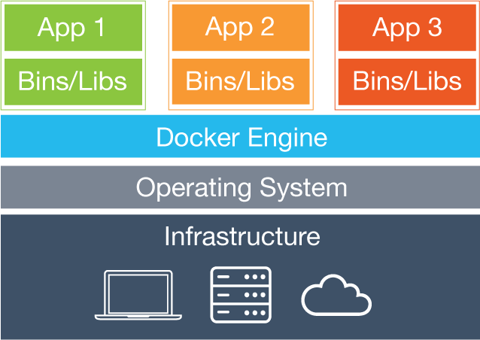
Virtual Machines vs. Containers - Architecture
Containers
VMs
Virtual Machines
Each virtual machine (VM) includes the app, the necessary binaries and libraries and an entire guest operating system
Containers
Containers include the app & all of its dependencies, but share the kernel with other containers.
Run as an isolated process in userspace on the host OS
Not tied to any specific infrastructure – containers run on any computer, infrastructure and cloud.
Notes:
Now, let's look at how a virtual machine (VM) is different from a container.
While containers may sound like a VM, the two are distinct technologies. With VMs each virtual machine includes the application, the necessary binaries and libraries and the entire guest operating system.
Whereas, Containers include the application, all of its dependencies, but share the kernel with other containers and are not tied to any specific infrastructure, other than having the Docker engine installed on its host – allowing containers to run on almost any computer, infrastructure and cloud.
Note - at this time, Windows and Linux containers require that they run on their respective kernel base, therefore, Windows containers cannot run on Linux hosts and vice versa.

Slide 13
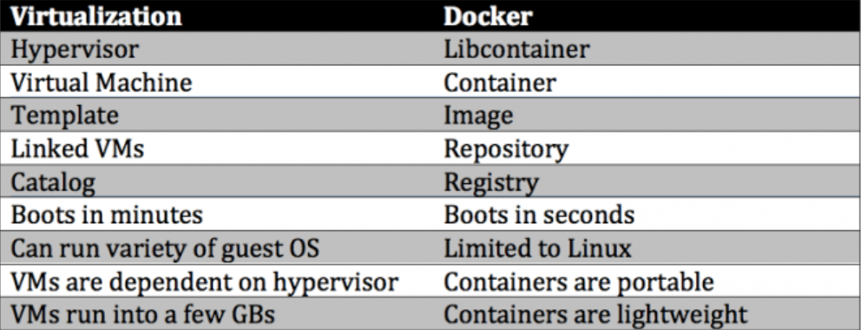
Virtual Machines vs. Containers – Key differences

Slide 14
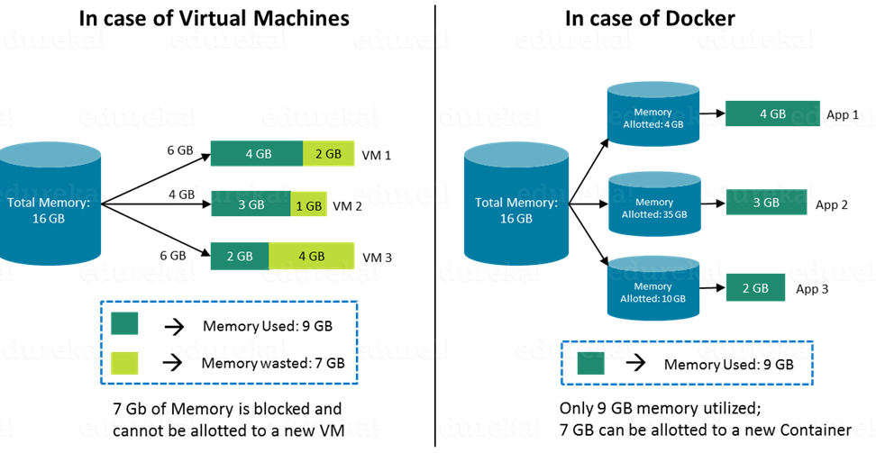
Virtual Machines vs. Containers - Size

Slide 15
What is Docker?
Docker is an Open platform for developers and sysadmins to build, ship and run distributed applications.
It can run on most Linux distributions, Windows and Mac OS running Docker Engine (Toolbox).
It is supported by most of cloud providers and provide a popular Dev/Test, CI & DevOps platform for many use cases.
Notes:
Intro to Basic Container Concepts
A container is a runtime instance of a Docker image.
https://docs.docker.com/engine/reference/glossary/#/container
Docker is the company and containerization technology.
https://docs.docker.com/engine/reference/glossary/#/docker

Slide 16
First Public release of Docker
March 2013, PyCon, Santa Clara:
"Docker" is shown to a public audience for the first time.
It is released with an open source license.
Very positive reactions and feedback!
The dotCloud team progressively shifts to Docker development.
The same year, dotCloud changes name to Docker.

Slide 17
Basic Architecture

Slide 18
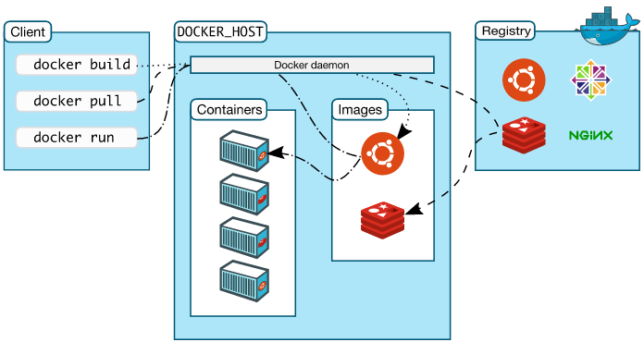
Docker Architecture
Docker Engine – Docker Daemon, REST API, CLI.
Docker client – Command Line Interface (CLI) for interfacing with the Docker
Image – Hierarchies of files built from a Dockerfile, the file used as input to the docker build command
Container – Running instance of an Image using the docker run command
Dockerfile – Text file of Docker instructions used to assemble a Docker Image
Docker Hub (Registry) – Image repository
Notes:
Jumping back a bit, there is a new nomenclature that Docker introduces, here are terms that you will need to be familiar with.
Each of these Docker technologies will be explored in this HOL. It's important to note that this core technology is open source. There are other technologies in the greater ecosystem, that could be open source, or licensed or even a hybrid, with a paid support option.

Slide 19

Docker Engine
Docker Engine is a client-server application with these major components:
A server which is a type of long-running program called a daemon process (the dockerd command).
A REST API which specifies interfaces that programs can use to talk to the daemon and instruct it what to do.
A command line interface (CLI) client (the docker command).
Notes:
The Docker Engine is THE core piece of technology that allows you to run containers. In order for a container to run on any Linux host, at a minimum, the Docker Engine needs to be installed. Then the container can run on any Linux host where Docker Engine is installed, providing the benefit of portability, without doing any application specific configuration changes on each host.

Slide 20
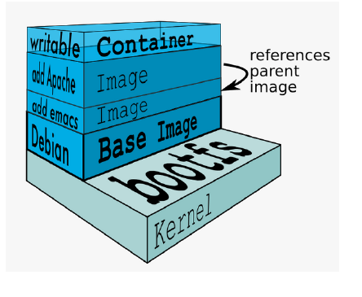
Docker Images
An image is a collection of files and some meta data
Images are comprised of multiple layers, multiple layers referencing/based on another image (Union File System)
Each image contains software you want to run
Every image contains a base layer
Layers are read only
Source: Docker docs and https://docs.docker.com/glossary/
Notes:
Docker images are a collection of files, which have everything needed to run the software application inside the container. However, they are ephemeral, meaning that any data that is written inside the container, while it is running, will not be retained.
If the container is stopped and restarted from its image, the container will run exactly the same as the first time, absent of any changes made during the last run cycle. Changes to the container either have to be made during the image creation process, using the Dockerfile that become part of the image, or data can be retained by mounting a persistent storage volume, from inside the container to the outside. This will be explored further in the HOL exercises below.

Slide 21
Docker Container
Image
Run
Container
Operating System
Software
Application Code
Notes:
Docker Run
Containers have a main process
The containers stop when that process stops
Containers have names

Slide 22
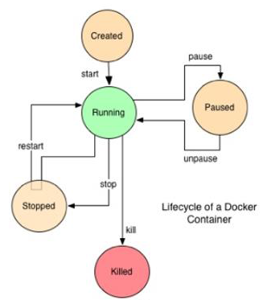
Docker Container Lifecycle
Conception
BUILD an Image from a Dockerfile
Birth
RUN (create+start) a container
Reproduction
COMMIT (persist) a container to a new image
RUN a new container from an image
Sleep
KILL a running container
Wake
START a stopped container
Death
RM (delete) a stopped container
Extinction
RMI a container image (delete image)

Slide 23
Lab1
Docker Install & basic commands

Slide 24
Docker Install
Installation process for Docker on Ubuntu 16.04 machine.
Install required Packages
sudo apt-get install curl apt-transport-https ca-certificates software-properties-common
2. Setup Docker repository
curl -fsSL https://download.docker.com/linux/ubuntu/gpg | sudo apt-key add -
sudo add-apt-repository "deb [arch=amd64] https://download.docker.com/linux/ubuntu $(lsb_release -cs) stable“
3. Install Docker On Ubuntu
sudo apt-get update
sudo apt-get install -y docker-ce
sudo systemctl status docker

Slide 25
Docker CLI – Common / useful commands
docker pull : pull images/volumes from Docker Registry.
docker images : list all images on the local volume.
docker run : run docker image.
docker ps : list running docker containers (analogous to ps).
docker ps –a : list all containers including not running.
docker logs : show log data for a running or stopped container.
docker rm : remove/delete a container | docker rmi : remove/delete an image.
docker tag : name a docker image.
docker build : build docker image from Dockerfile.
docker login : login to registry.
docker push : push images/volumes to Docker Registry.
docker inspect : return container run time configuration parameter metadata.

Slide 26
Hello World
In your Docker environment, just run the following command:
$ docker run busybox echo hello world
hello world
(If your Docker install is brand new, you will also see a few extra lines, corresponding to the download of the busybox image.)

Slide 27
A more useful container
This is a brand new container.
It runs a bare-bones, no-frills ubuntu system.
-it is shorthand for -i -t.
-i tells Docker to connect us to the container's stdin. (interactive mode)
-t tells Docker that we want a pseudo-terminal. (tty)

Slide 28
A more useful container
Try to run figlet in our container.
Alright, we need to install it.

Slide 29
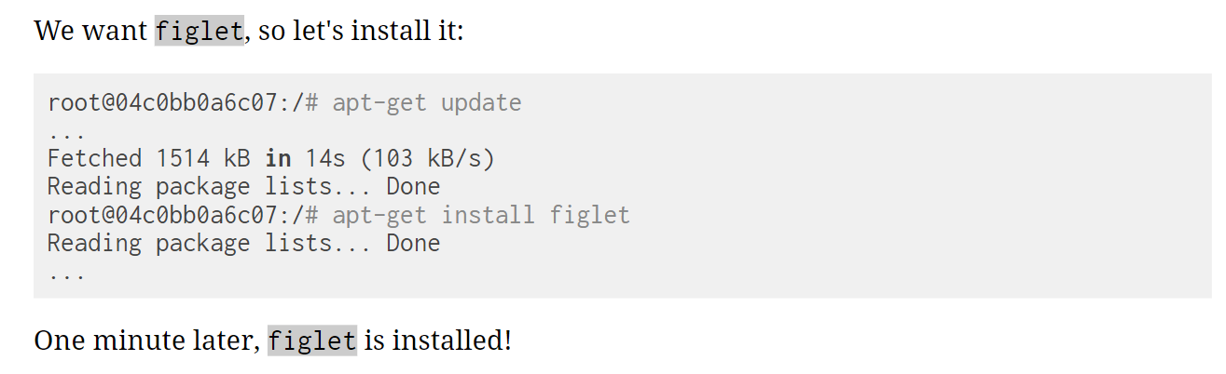
Do something in our container

Slide 30
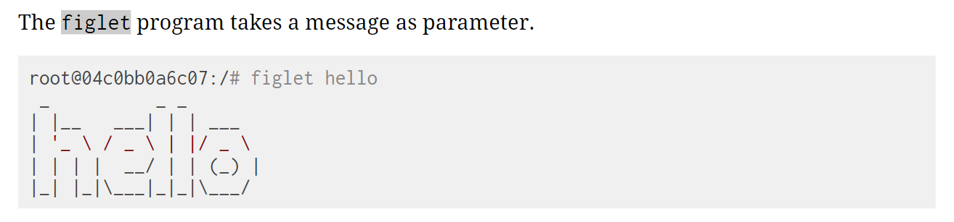
Try to run installed program “figlet”

Slide 31
Comparing the container and the host
Exit the container by logging out of the shell, with ^D or exit.
Now try to run figlet. Does that work?
(It shouldn't; except if, by coincidence, you are running on a machine where figlet was installed before.)

Slide 32
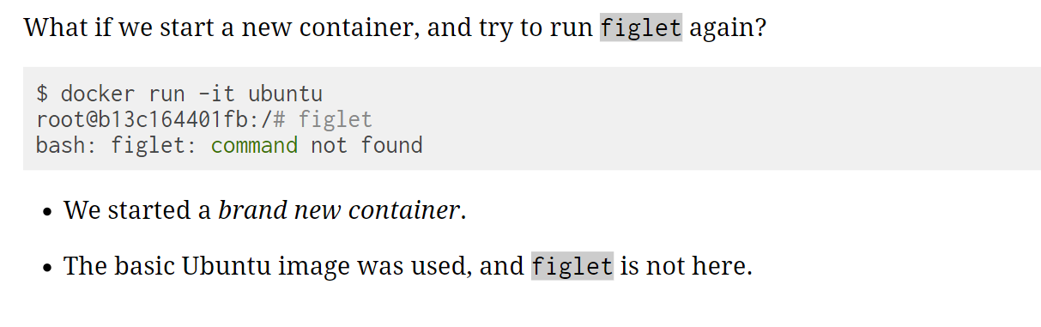
Starting another container

Slide 33
Where is my container
Can we reuse that container that we took time to customize?
We can, but that's not the default workflow with Docker.
What's the default workflow, then?
Always start with a fresh container. If we need something installed in our container, build a custom image.
That seems complicated!
We'll see that it's actually pretty easy!
And what's the point?
This puts a strong emphasis on automation and repeatability. Let's see why ...

Slide 34
Pets Vs Cattle
In the "pets vs. cattle" metaphor, there are two kinds of servers.
Pets:
have distinctive names and unique configurations
when they have an outage, we do everything we can to fix them
Cattle:
have generic names (e.g. with numbers) and generic configuration
configuration is enforced by configuration management, golden images ...
when they have an outage, we can replace them immediately with a new server
What's the connection with Docker and containers?

Slide 35
Local development environments
When we use local VMs (with e.g. VirtualBox or VMware), our workflow looks like this:
create VM from base template (Ubuntu, CentOS...)
install packages, set up environment
work on project
when done, shut down VM
next time we need to work on project, restart VM as we left it
if we need to tweak the environment, we do it live
Over time, the VM configuration evolves, diverges.
We don't have a clean, reliable, deterministic way to provision that environment.

Slide 36
Local development with Docker
With Docker, the workflow looks like this:
create container image with our dev environment
run container with that image
work on project
when done, shut down container
next time we need to work on project, start a new container
if we need to tweak the environment, we create a new image
We have a clear definition of our environment, and can share it reliably with others.

Slide 37
Background containers

Slide 38
Objectives
Our first containers were interactive.
We will now see how to:
Run a non-interactive container.
Run a container in the background.
List running containers.
Check the logs of a container.
Stop a container.
List stopped containers.

Slide 39
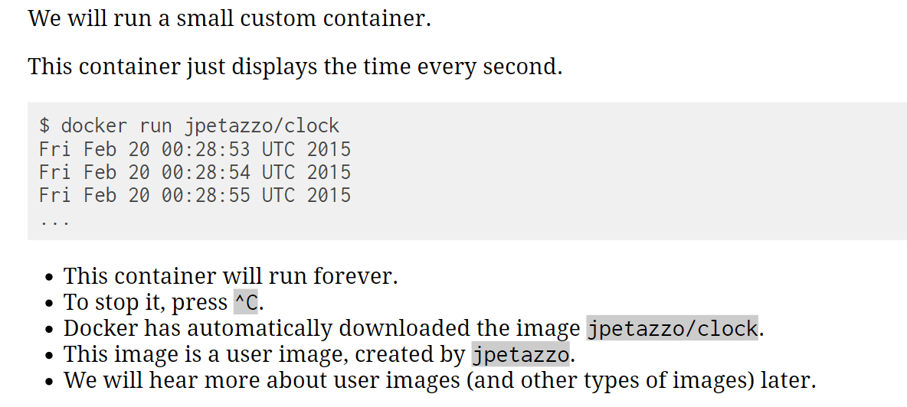
A non-interactive container

Slide 40
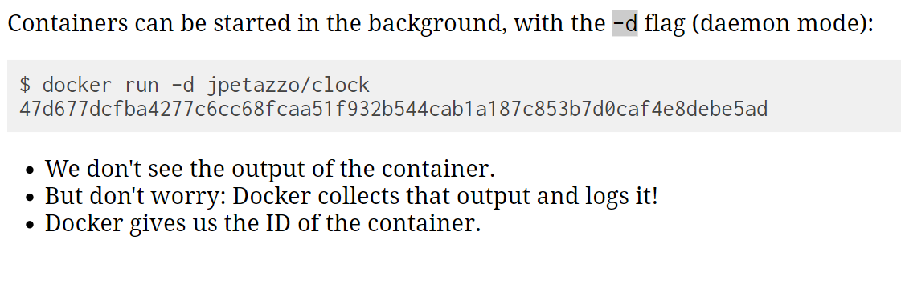
Run a container in the background

Slide 41
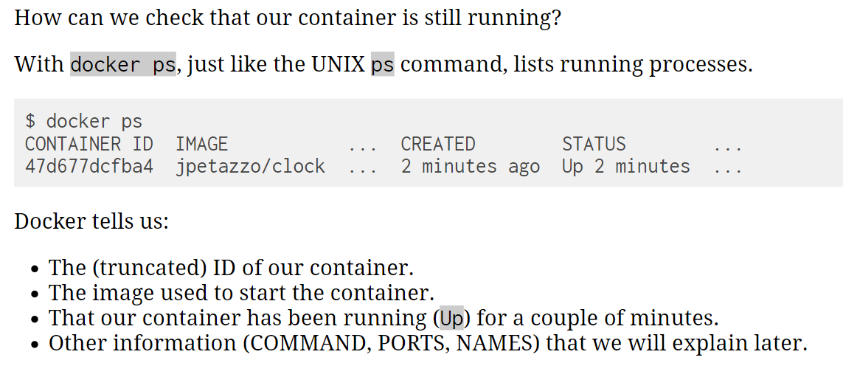
List running containers

Slide 42
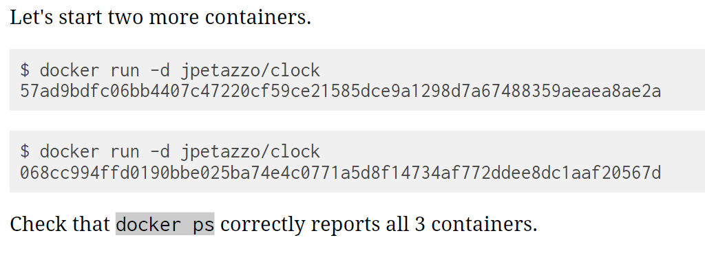
Starting more containers

Slide 43
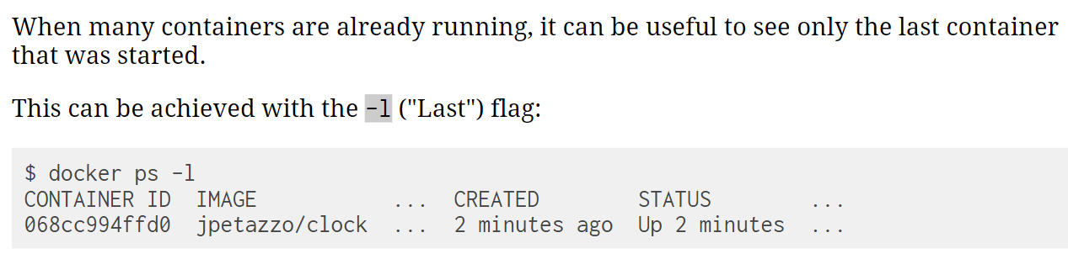
Viewing only the last container started

Slide 44
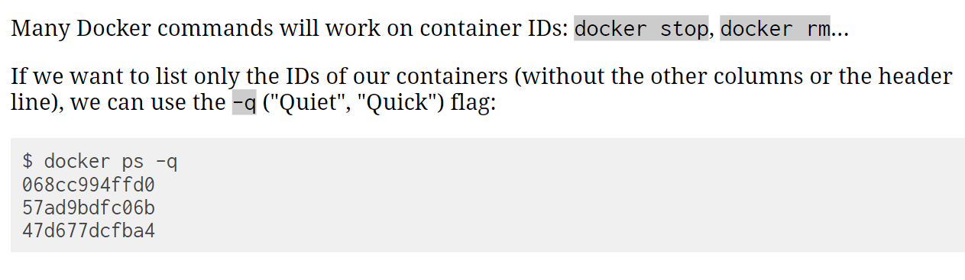
Viewing only the IDs of the containers

Slide 45
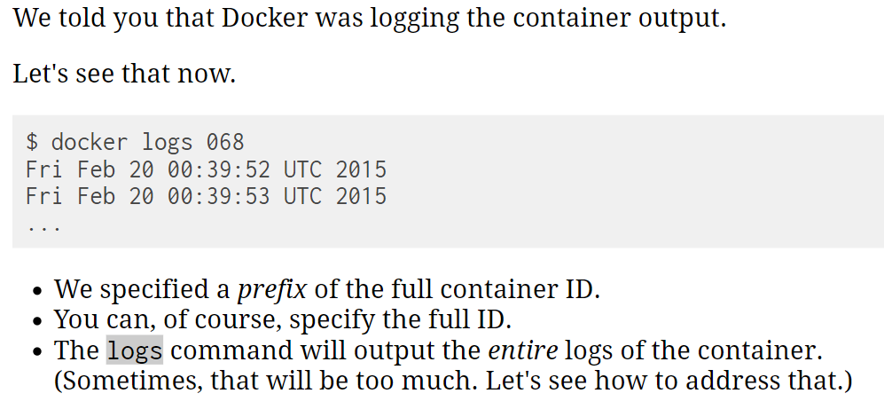
View the logs of a container

Slide 46
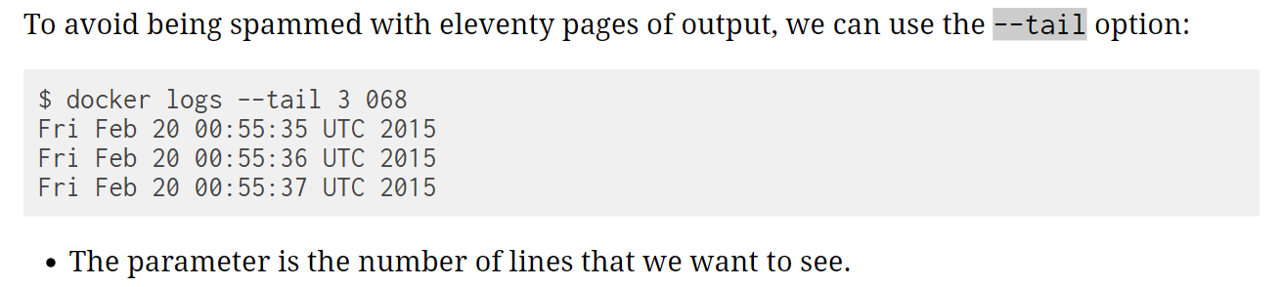
View only the tail of the logs of a container

Slide 47
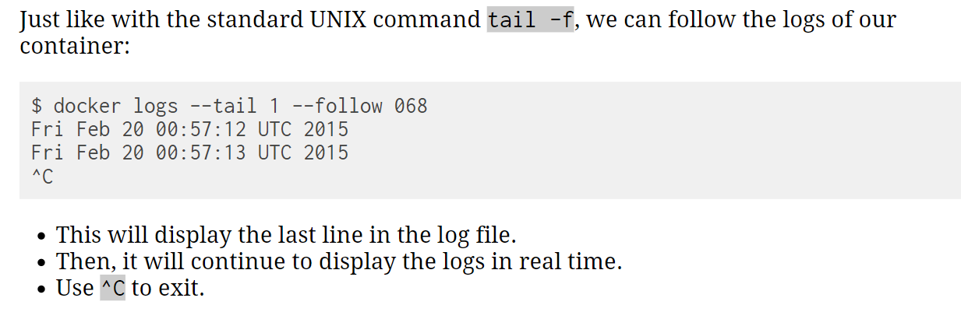
Follow the logs in real time

Slide 48
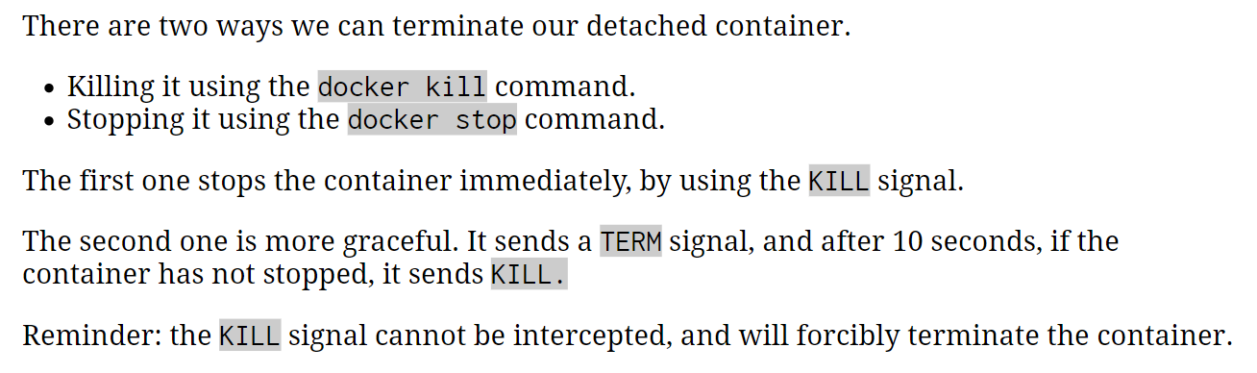
How to stop our containers

Slide 49
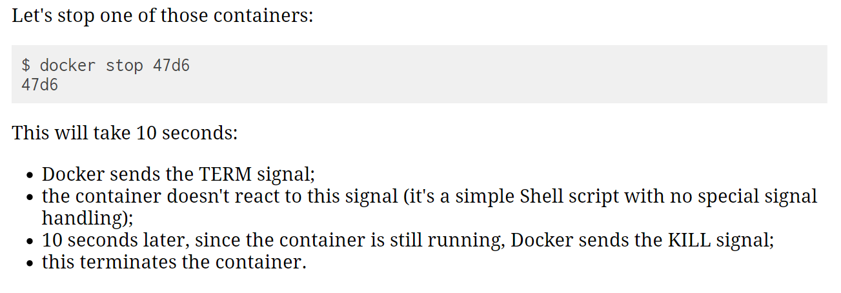
stop container using stop

Slide 50
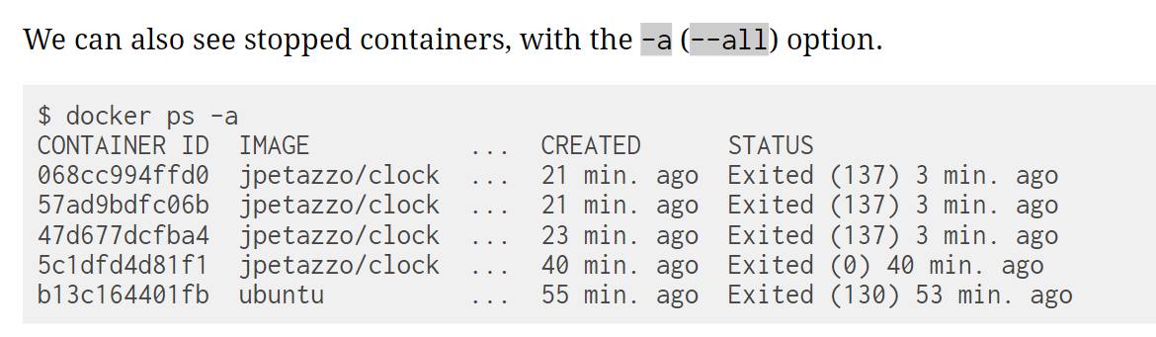
List stopped containers

Slide 51
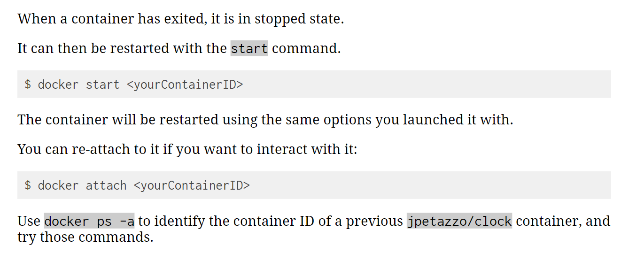
Restarting a container

Slide 52
Modified before this point
https://container.training/intro-selfpaced.yml.html#127

Slide 53
Restarting a container

Slide 54
Docker Run
Pulls the image and runs it as a container
docker run [OPTIONS] IMAGE [COMMAND] [ARG...]
Examples:
docker run hello-world # install and run hello-world (foreground mode by default)
docker run -it ubuntu /bin/bash # run ubuntu container and log into it.
docker run -d -p 9090:80 -t <image id> # -d : detached mode
# -p : port forwarding 9090 -> host
80 -> container
docker exec -it <container id> /bin/bash #login to running container

Slide 55
Build Docker Images - Dockerfile

Slide 56
Docker Flow
DockerFile
Image
Run
Container
Build

Slide 57
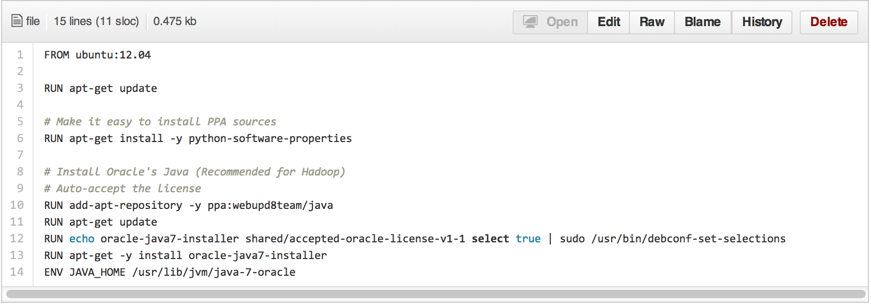
Dockerfile
• Like a Makefile
(shell script with keywords)
• Extends from a Base Image
• Results in a new Docker Image
• Imperative, not Declarative
A Docker file lists the steps needed to build an images
• docker build is used to run a Docker file
• Can define default command for docker run, ports to expose, etc

Slide 58
Lab2
Setup website using Nginx
(refer github for code : static-site)

Slide 59
Static Site using Nginx
Example Static Site Dockerfile
Docker build image CLI example
FROM nginx
COPY wrapper.sh /
COPY html /usr/share/nginx/html
CMD ["./wrapper.sh"]
$ docker build -t static-site:1.0 .
NOTE: The “.” references Dockerfile in local directory
Oracle Confidential – Restricted

Slide 60
Containering an application using dockerfile
Example Static Site Dockerfile
Docker build image CLI example
FROM nginx
COPY wrapper.sh /
COPY html /usr/share/nginx/html
CMD ["./wrapper.sh"]
$ docker build -t static-site:1.0 .
NOTE: The “.” references Dockerfile in local directory
Oracle Confidential – Restricted

Slide 61
Use Cases

Slide 62
Excellent Use Cases for Containers
Ready to Run Application Stacks
Excellent for Dev/Test setups
Deployment in Seconds, not Hours/Days
Start Up, Tear Down Quickly
Front-End App Servers
Highly horizontally scalable
Fast A/B, Rolling Deployments
Traditional Technologies - MW/Backend
New App Dev & Microservices
Refactor all or part of legacy app
Containers are great for Microservices
Server Density
Containers can use dynamic ports
Run many of the same app on a server
instead of one per VM
One-Time Run Jobs and Analytics
Run the Job / Analysis and quit

Slide 63
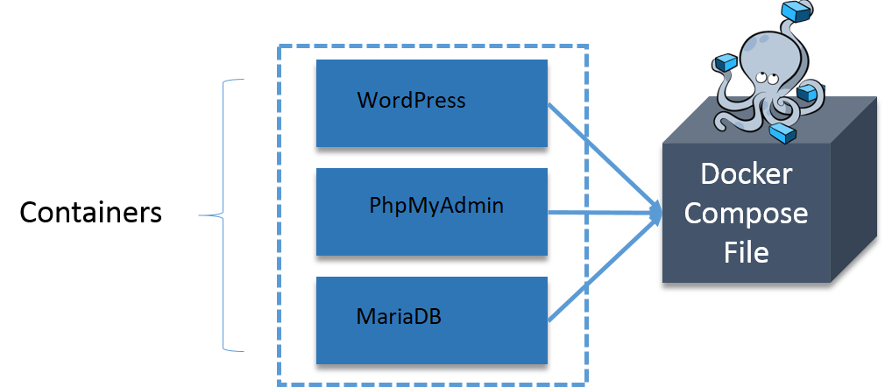
Docker Compose
Docker Compose
Docker Tool for defining and running multi-container Docker applications
Notes:
Running multi container environment for multiple purposes:
Mail (Messaging) Server
Web Server + DB
Caching
Docker compose is written in YAML
Dingle command to manage all services

Slide 64
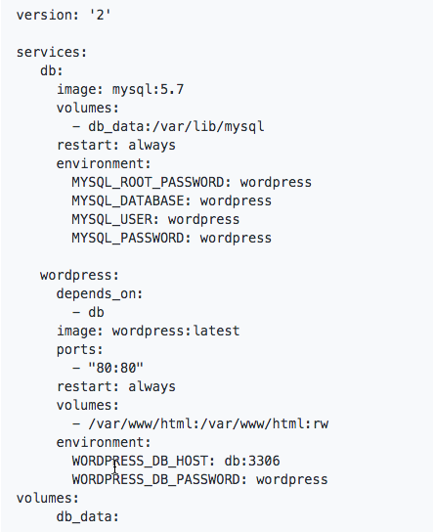
Deploy application using Docker Compose
$ docker-compose up -d
Notes:
Running multi container environment for multiple purposes:
Mail (Messaging) Server
Web Server + DB
Caching
Docker compose is written in YAML
Dingle command to manage all services

Slide 65
Lab3
Setup Wordpress site using docker compose
(refer github for code : docker-compose)

Slide 66
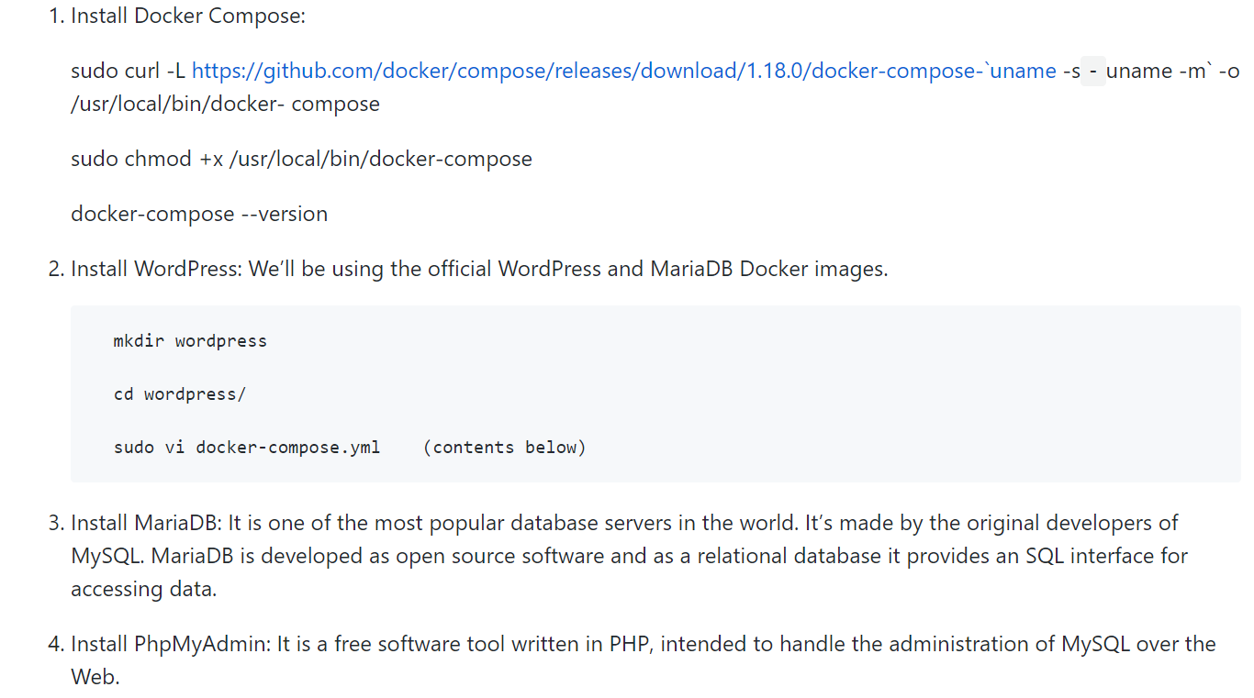
Setup Wordpress site using docker compose

Slide 67
Setup Wordpress site using docker compose
5. Create The WordPress Site:
##############################################
#sudo vi docker-compose.yml
---
---
##############################################
6. Now start the application group:
docker-compose up -d
7. Now, in the browser go to port 8080, using your public IP or host name, as shown below
localhost:8080 # Fill this form and click on install WordPress.
8. Now visit your server’s IP address again to port 8181 this time. You’ll be greeted by the phpMyAdmin login screen:
localhost:8181

Slide 68
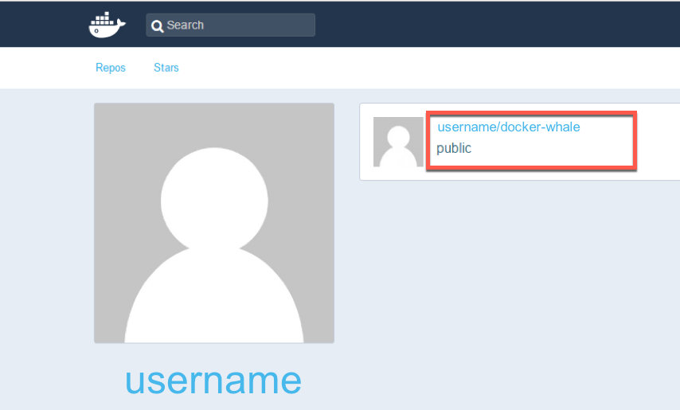
Docker Hub
Docker Inc.
Repository
public and private images
Enables images to be shared and moved off the laptop
Example usage:
$ docker tag docker-whale:latest username/docker-whale:latest
$ docker push username/docker-whale:latest
$ docker pull username/docker-whale:latest

Slide 69
Docker Swarm
Docker Swarm is a technique to create and maintain a cluster of Docker Engines.
The Docker engines can be hosted on different nodes, and these nodes, which are in remote locations, form a Cluster when connected in Swarm mode.
Notes:
Running multi container environment for multiple purposes:
Mail (Messaging) Server
Web Server + DB
Caching
Docker compose is written in YAML
Dingle command to manage all services

Slide 70
Why Docker is Hot

Slide 71

Why Docker is Hot – Its simple, Devs love it
Dev/Test of Legacy Apps
New App Dev (including parts of legacy apps)
Code Agility, CI/CD Pipeline, DevOps
Adoption of Open Source
Microservices & Cloud Native Apps
Notes:
Additionally, in speaking with hundreds of organizations that are exploring and using Docker, these are the core advantages that Docker brings.

Slide 72



HOL
Notes:
Verify Docker Engine Hands on Lab Environment
In this first section you are going to verify that you are able to connect to your Docker Engine environment as requested in the Prerequisites document. Please access the environment now, and execute the following commands at the terminal.
*Note - if you are using one of the Worker Nodes in an Oracle Container Cloud Service instance, as your Docker Engine environment, access it via SSH per these instructions
Optional - for convenience, run as root, so that you do not have to preface everything with sudo (not applicable if you are running Docker for Windows):
$ sudo -s Now, here is the Docker specific command to check what version is installed:
$ docker --version If Docker is installed and running, you should see an output of something like this:
Docker version 1.1x.x, build 57bf6fd
Hello Helloworld
Run Docker’s Hello-world example:
$ docker run hello-world
Since the "hello-world" image is not available locally on the host, the command automatically pulls the hello-world image from the public Docker Hub image repository and runs the container in the foreground.

Slide 73
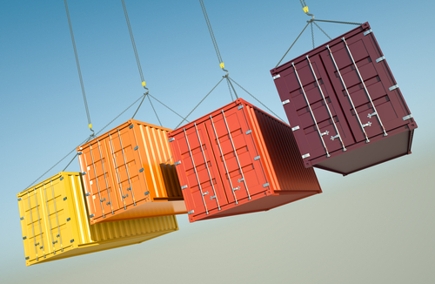
Why Containers?
Developers care because:
IT cares because:
Quickly create ready-to-run packaged applications, low cost deployment and replay
Automate testing, integration, packaging
Reduce / eliminate platform compatibility issues (“It works in dev!”)
Support next gen applications (microservices)
Improve speed and frequency of releases, reliability of deployments
Makes app lifecycle efficient, consistent and repeatable – configure once, run many times
Eliminate environment inconsistencies between development, test, production
Improve production application resiliency and scale out / in on demand
Notes:
Ok, so those are some of the mechanics of the technology, but why is Docker popular among all types of IT people? Let's look at these proof points from Developers and IT Ops.

Slide 74

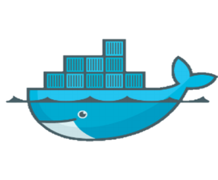
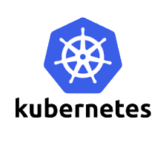
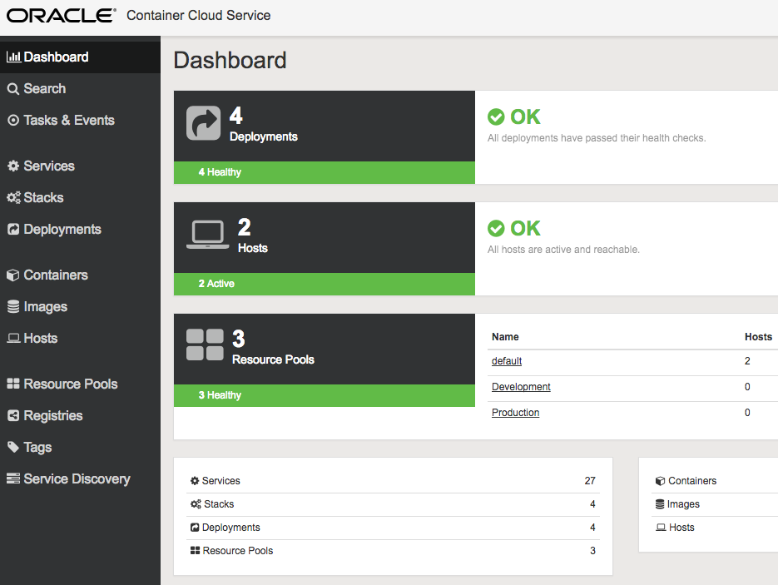
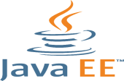
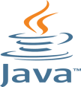


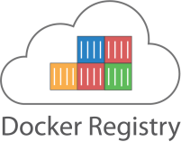
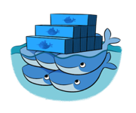




Oracle Cloud and Docker Containers
Compute CS
Container CS
Application Container CS
DIY Container Management
Oracle Managed Container Service
Docker-based Cloud Polyglot Platform
IaaS
CaaS
PaaS

Slide 75
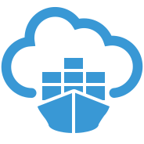
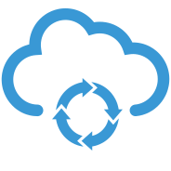
The Docker DevOps Cycle
Plan
Code
Build
Release
Deploy
Test
Operate
Monitor
OPC services featuring:
Oracle Developer Cloud Service
Now Includes Docker Image Build Function*
Oracle Container Cloud Service
Deploy, Operate, Monitor
Container CS
Dev CS

Slide 76
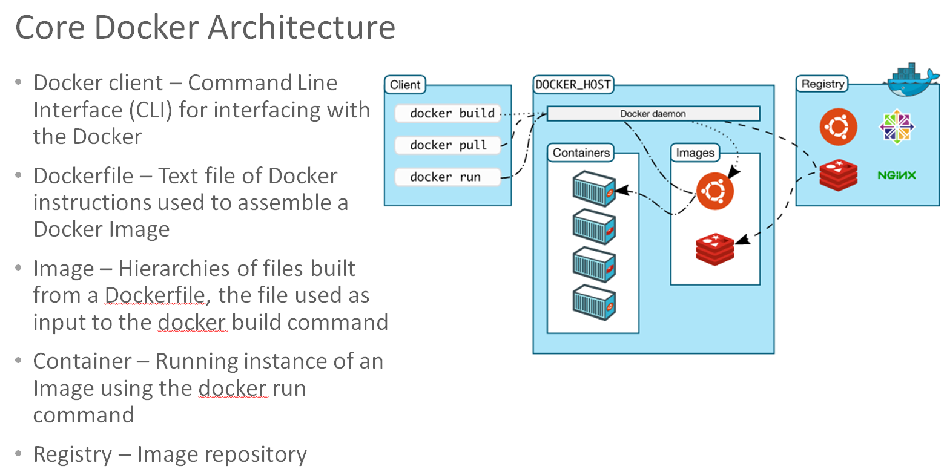
Containers are Portable, but How about Advanced Functions
Advanced Functions
Orchestration, Monitoring, Operations, Service Discovery
Docker Environment Provisioning
Fragmented Market Solutions
Kubernetes
Swarm, Docker Data Center, Docker Cloud
Consul, ETCD, Docker Networking
etc
+

Slide 77
Additional Resources
Resource | Location
Entry Level Hands-on Lab | https://github.com/oracle/cloud-native-devops-workshop/tree/master/containers/docker001
Oracle Container Cloud Service | https://cloud.oracle.com/en_US/container
Official Image Registries | Oracle Images on the Docker Store Oracle Container Registry

Slide 78
Questions?

